Slide 1
How to Turn Off HID EEM Mode

Slide 2
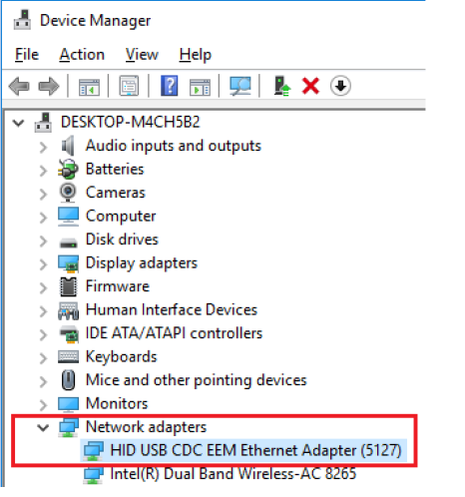
Turn Off HID EEM Mode
1. Check the driver is installed for EEM in Device Manager.

Slide 3
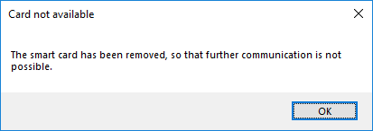
Customer Feedback Information
2. Put the RFID card close to the HID-RFID device.
MUST BE DONE –
3. Open the EEMTool.exe
If without step-2, you will find the reminder message.

Slide 4
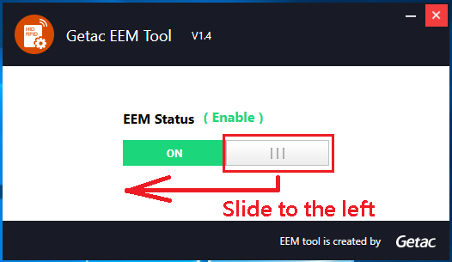
Turn Off HID EEM Mode
4. Slide the switch button to the left to disable the EEM mode.

Slide 5
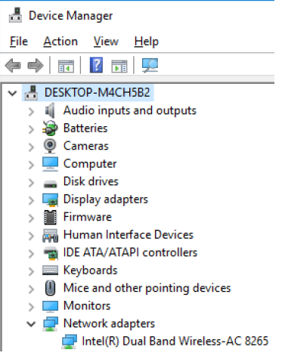
Turn Off HID EEM Mode
5. Check the EEM device, not in the Device Manager.
6. Now, turn off EEM mode is DONE.

Slide 6
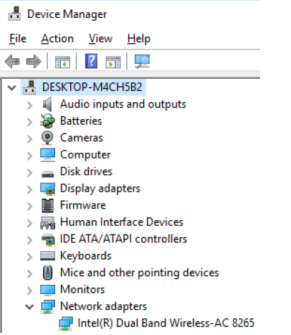
Turn Off HID EEM Mode
5. Check the EEM device, not in the Device Manager.
6. Now, turn off EEM mode is DONE.

Slide 7
Turn On HID EEM Mode
1. Put the RFID card close to the HID-RFID device.
- MUST BE DONE –
2. Open the EEMControlTool.exe
If without step-1, you will find the reminder message.

Slide 8
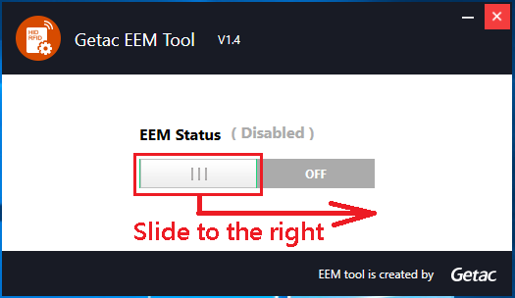
Turn On HID EEM Mode
3. Slide the switch button to the right to enable the EEM mode.

Slide 9
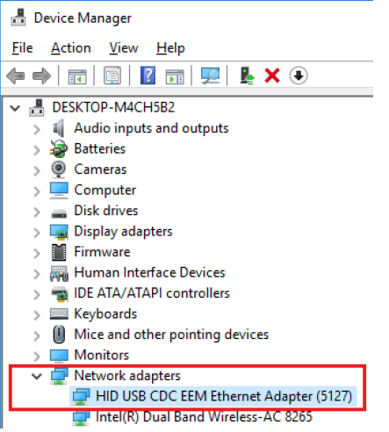
Turn On HID EEM Mode
4. Check the EEM device in Device Manager.
5. Now, turn on EEM mode is DONE.

